Slide 1




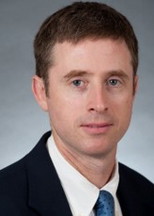
Artificial Intelligence in Paediatric Urology:
A Brave New World?
Bernhard Haid
(AUS)
Luke Harper
(FR)
Caleb Nelson
(USA)
ESPU-RESEARCH COMMITTEE SESSION
18 APRIL 2024

Slide 2
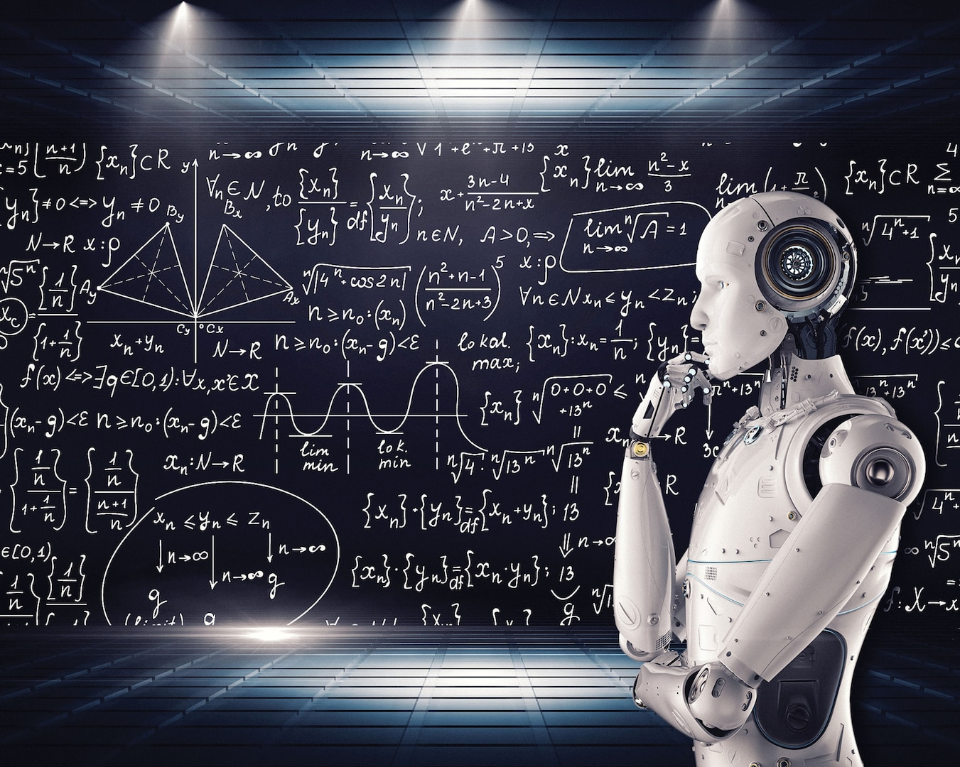
Artificial Intelligence (AI) is transforming medicine and research
What is AI’s current and future role in paediatric urology?

Slide 3
Framework of today’s discussion
1) Definitions/terminology
2) AI in clinical medicine
3) AI as a research tool
4) AI in education/workforce issues
5) Pitfalls of AI

Slide 4
Definitions and terminology

Slide 5

Artificial intelligence
computer systems performing tasks that typically would require human intelligence
applications of algorithms and models that
  learn from large data sets
  adapt to new information
  take decisions and make predictions
  generate new, transformed information
huge variety of applications and ideas

Slide 6
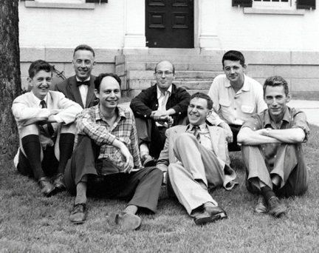
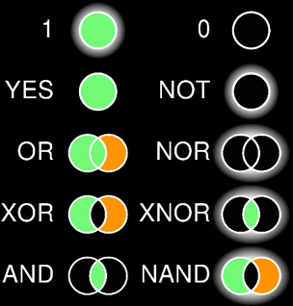
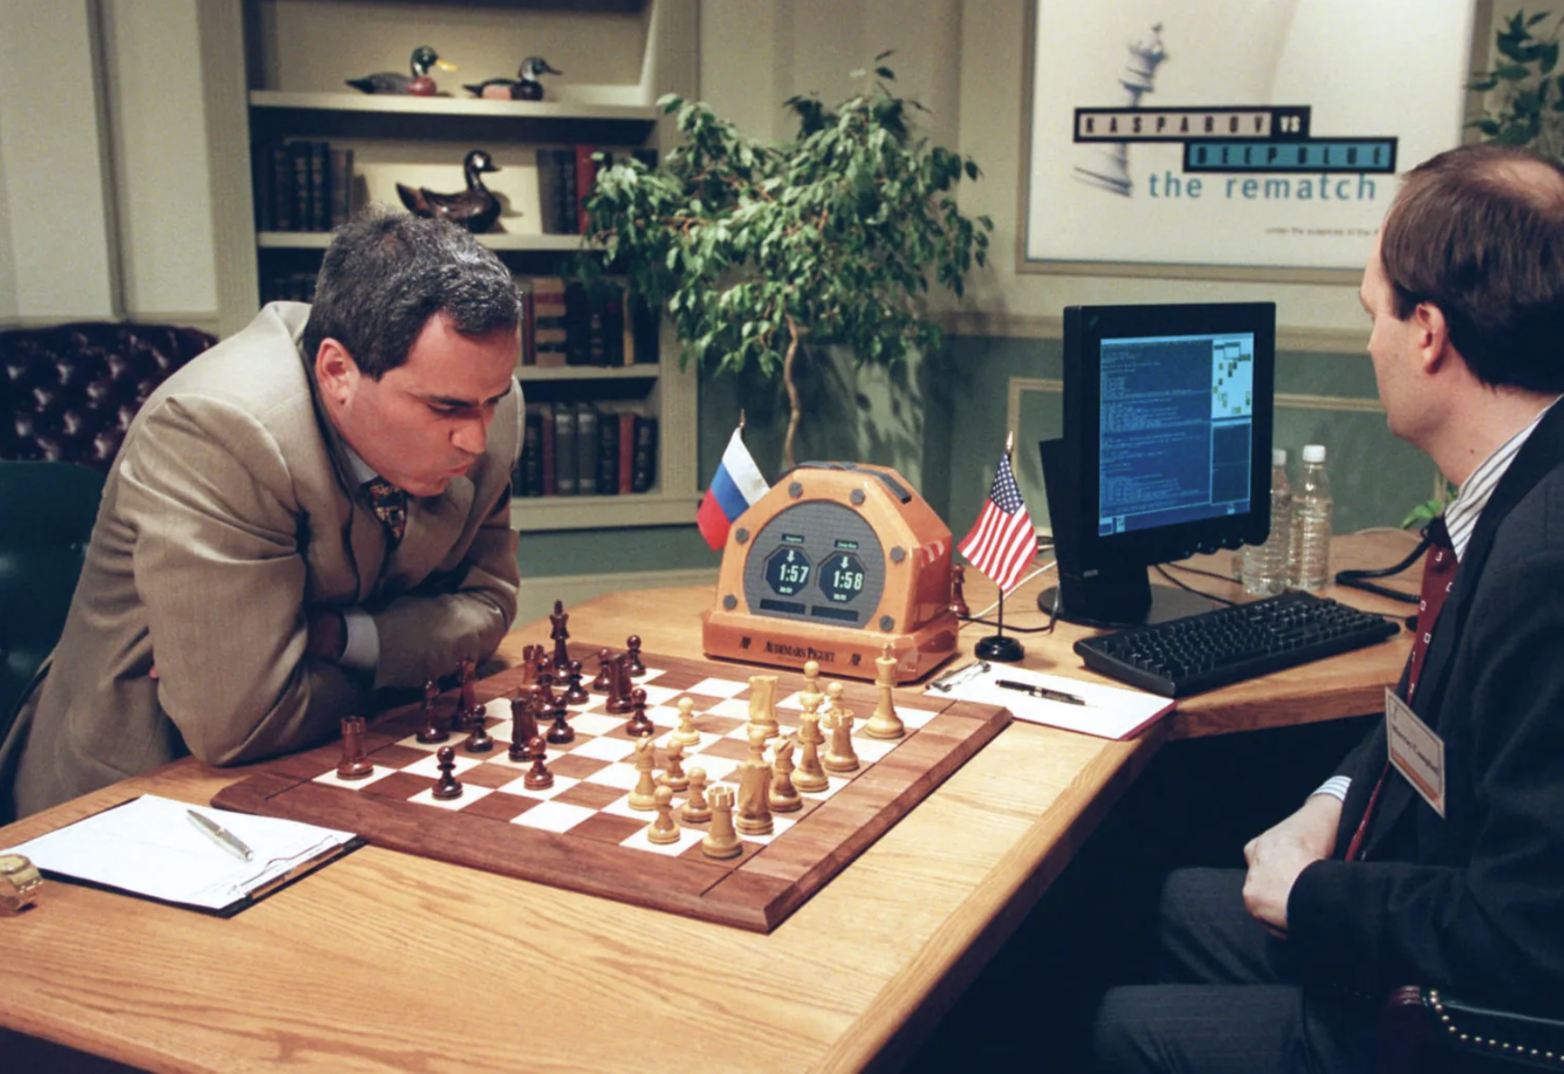
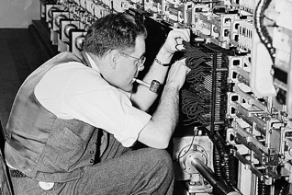
Something „new“? … a short historical perspective
40ies-50ies: early concepts – electronic computers
1956: John McCarthy, Dartmouth Conference
50ies – 80ies: Symbolic AI – simple algorithms, e.g. „Logic Theorist“
90ies-2000s: Machine Learning resurgence: neuronal networks, Bayesian networks
10s: big data / deep learning, convolutional and recurrent neuronal networks
Notes:
Darthmouth Confereince (IBM, Rockefeller Foundation)
We propose that a 2-month, 10-man study of artificial intelligence be carried out during the summer of 1956 at Dartmouth College in Hanover, New Hampshire. The study is to proceed on the basis of the conjecture that every aspect of learning or any other feature of intelligence can in principle be so precisely described that a machine can be made to simulate it. An attempt will be made to find how to make machines use language, form abstractions and concepts, solve kinds of problems now reserved for humans, and improve themselves. We think that a significant advance can be made in one or more of these problems if a carefully selected group of scientists work on it together for a summer.
Logic Theorist: https://www.youtube.com/watch?v=HfPXr90HXSY
40-50: Alan Turing in the Harvard Gazette

Slide 7

History of AI in healthcare – 3 Epochs
Howell, M. D., Corrado, G. S., & DeSalvo, K. B. (2024). Three Epochs of Artificial Intelligence in Health Care. JAMA, 331(3), 242-244.
Notes:
Two key elements differentiate AI 2.0 from AI 3.0
- AI 2.0 is task-specific. It does one thing at a time. If an individual wants it to do something else, they will need a new dataset and to train a new model.
- AI 2.0 for the most part predicts things or classifies them. Its ability to generate new words, images, or other content is limited.
- AI 3.0 can do many different tasks without being retrained. For example, a simple text instruction will change the model’s behavior. A prompt like “Write this note for a specialist consultant” and “Write this note for the patient’s mother” will produce markedly different content.
- creating responses that are near-indistinguishable from those written by people; and carrying on extended conversations.
Med-PaLM and Med-PaLM 2 are medically tuned foundation models, developed at Google
- reached expert-level performance on medical licensing examination–style questions
- able to write long-form answers to people’s health questions. When physicians compared Med-PaLM 2’s answers vs those written by physicians without knowledge of the origin, they strongly preferred the model’s answers on 8 of 9 dimensions evaluated.

Slide 8


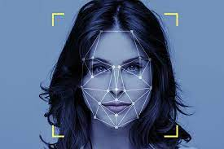
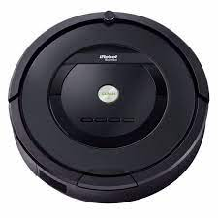
Main types of AI
machine learning
  learning from experience without being explicitely programmed
  an email spam filter learning to identify new spam emails based on previous patterns learned
natural language processing / large language models
  understand, interpret and generate human like text (and imagages)
  chatbots like ChatGPT Generative Pretrained Transformer
computer vision
  image recongnition, object detection and scene understanding
  facial recognition used in security systems
robotics
  autonomous mobile and learning devices
  Roomba – the autonomous vacuum cleaner

Slide 9
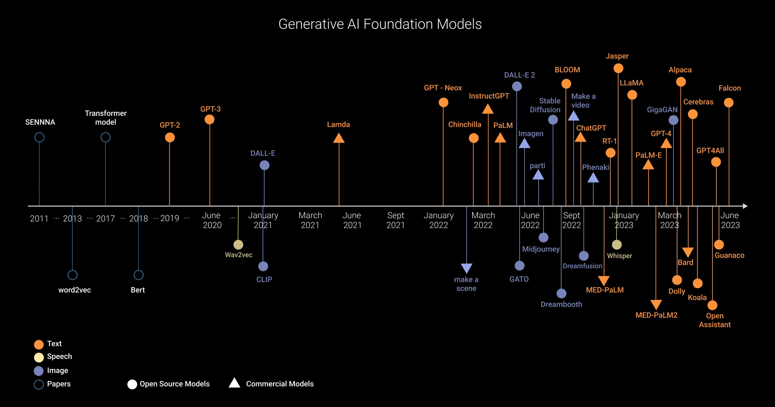
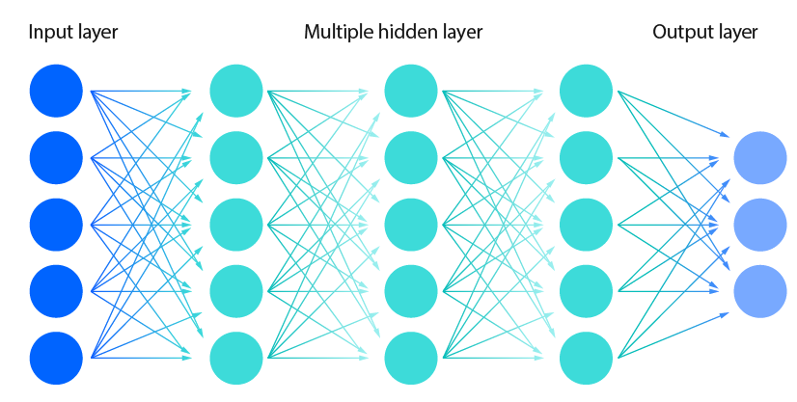
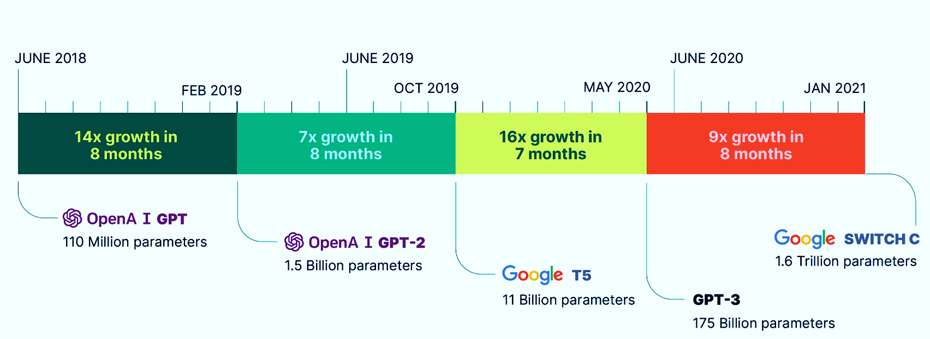
Terms and tools in AI
Algorithm
Neural network: interconnected nodes- inspired by the human brain
Deep learning: use of typically multilayered neuronal
Foundation models: up to trillions of parameters used
Notes:
Algorithm : step by step procedure to perform a task
multilayered neuronal networks = deep neural networks
Supervised: labeled data with input-output pairs
Unsupervised: without labeled output, the algorithm learns patters without predefined categories
Artificial General Intelligence (AGI): hypothetical AI system that possesses general cognitive abilities, similar to human intelligence

Slide 10
AI in clinical medicine

Slide 11
AI in clinical medicine
Prediction models
  Algorithms that use clinical or research data to predict patient outcomes in future or concurrent test datasets
Computer vision
Signal Analysis
Prescription models

Slide 12
Prediction models in paediatric urology
UTI and VUR
  UTI diagnosis
  UTI recurrence/VUR incidence after UTI
  VUR resolution
  Reflux surgery results
Renal outcomes in PUV
Hydronephrosis outcomes
Hypospadias genotype
Enuresis incidence
Rhabdomyosarcoma survival
Clinic flow and timing

Slide 13

What if we could predict those patients with first febrile UTI who are most at risk of both recurrent UTI and VUR?
Joint collaboration of BCH and MIT……. Scott Wang MD
Use machine learning algorithms to develop prediction models using RIVUR/CUTIE data
Sort patients into “high-risk” and “low-risk” groups
Used “optimal classification tree” procedure
Low-risk of rUTI and VUR: defer VCUG after first febrile UTI
High-risk of rUTI and VUR: do VCUG after first febrile UTI

Slide 14
NIDDK
THE RIVUR STUDY
Randomized Intervention for children with
Vesico-Ureteral Reflux
(RIVUR)
Multicenter RCT (TMP-SMX vs. placebo) in children at 2-60 months with febrile UTI and VUR

Slide 15
NIDDK
THE CUTIE STUDY
Careful Urinary Tract Infection Evaluation
Observational cohort study of 195 children without VUR but otherwise eligible for RIVUR
Provides a non-VUR “control” group for RIVUR subjects

Slide 16
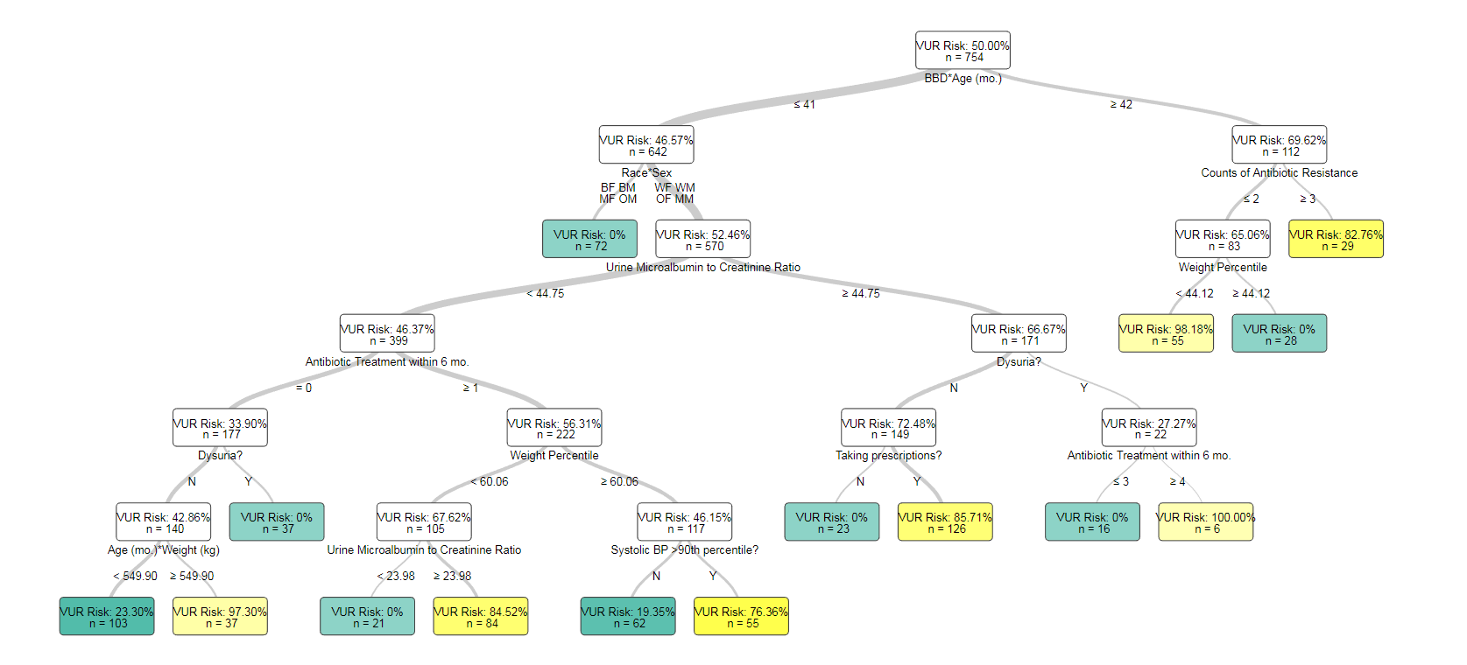
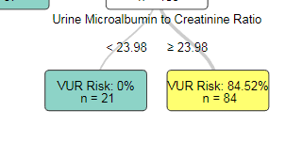
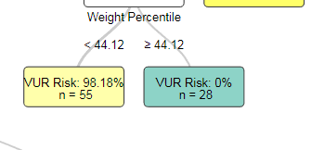

Slide 17
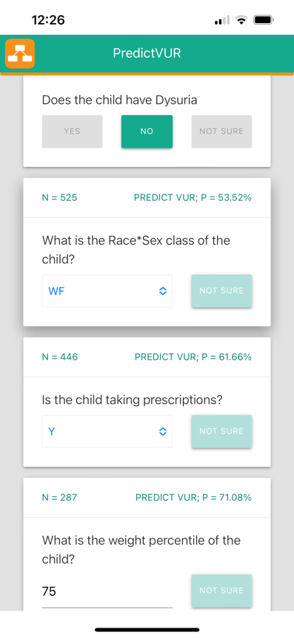
This algorithm available using an App
“PredictVUR” in the
App store

Slide 18
This effort illustrates the challenges and promise of AI in clinical medicine
Low availability of granular, high-quality data on large number of patients
RIVUR/CUTIE studies: complex expensive studies costing 10’s of millions $
Still - only provide data on a few hundred patients
Unbiased data on control/natural history cohorts are extremely hard to obtain

Slide 19
AI in clinical medicine
Prediction models
Computer vision
  Use of software algorithms to interpret clinical images (x-rays, ultrasounds, cross-sectional imaging)
Signal Analysis
Prescription models

Slide 20
Computer vision in paediatric urology
Grading of hydronephrosis
  Segmenting renal parenchyma
  Ratio of parenchyma to collecting system
  Classifying SFU score
  Evaluate need for MAG3
VUR grade
Urethral stricture
Wilms’ tumor
Hypospadias phenotype

Slide 21
Deep learning model
(deep convolutional neural
Networks) to assign SFU grades
to ultrasound images
[LC Smail 2020]

Slide 22
AI in clinical medicine
Prediction models
Computer vision
Signal Analysis
  Field of electrical engineering looking at time series data forms such as music, nerve conduction patterns, or seismic activity
Prescription models

Slide 23
Signal analysis in paediatric urology
Urodynamic studies
  Identification of detrusor overactivity
  Classification and severity of lower urinary tract dysfunction
  Measuring bladder compliance
Drainage curves of diuretic renal scans

Slide 24
Machine learning pipeline to
identify detrusor overactivity
during urodynamic studies
[KT Hobbs 2021]

Slide 25
AI in clinical medicine
Prediction models
Computer vision
Signal Analysis
Prescription models
  Algorithms that provide treatment recommendations (“prescriptions”) based on patient’s predicted outcome with or without treatment

Slide 26
Machine learning model to
identify those most likely to benefit from CAP [D Bertsimas et al. 2021]

Slide 27
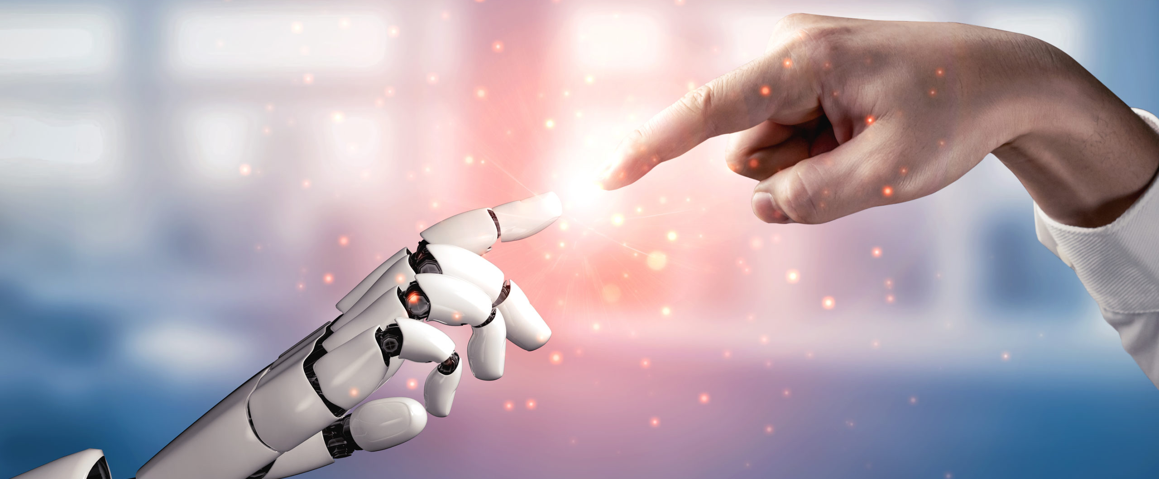
AI in Research and Education
Notes:
A randomized controlled study, also known as a randomized controlled trial (RCT), is a type of scientific research study that is widely used in the field of medicine, psychology, and other disciplines to evaluate the effectiveness of interventions or treatments. In an RCT, participants are randomly assigned into different groups, with each group receiving a different treatment or intervention. The groups are then followed up and compared to determine the effects of the interventions.
The key features of a randomized controlled study include:
Randomization: Participants are randomly assigned to different groups, which helps to eliminate selection bias and ensures that each group is comparable at the start of the study. Randomization helps to ensure that any differences observed between the groups are likely due to the interventions being studied, rather than other factors.
Control group: One or more control groups are used as a comparison group. The control group does not receive the intervention being studied, and serves as a reference to which the intervention group(s) are compared. This helps to establish the baseline against which the effects of the intervention can be measured.
Comparison: The effects of the interventions are compared between the different groups to determine their effectiveness. Typically, outcomes such as health outcomes, behavioral changes, or other relevant measures are assessed and compared between the groups.
Blinding: In some RCTs, blinding or masking is used to reduce bias. Blinding can be single-blind (where participants do not know their group assignment), double-blind (where both participants and researchers do not know the group assignment), or triple-blind (where participants, researchers, and those analyzing the data do not know the group assignment).
Randomized controlled studies are considered one of the gold standards for evaluating the effectiveness of interventions or treatments because they can provide high-quality evidence of causality and help establish the efficacy and safety of interventions in a controlled manner. However, they also have limitations and must be designed and conducted rigorously to minimize bias and ensure valid results.

Slide 28
AI as a tool for medical research
Study design
Medical writing
Reviewing

Slide 29

Study design
Optimize the design and execution of clinical trials:
  Patient Recruitment:
    Analyze electronic health records to predict potential candidates for clinical trials
    Natural Language Processing can analyze unstructured medical data
  Trial Design:
    Optimizing Protocols using historical data and identifying potential barriers to recruitment
    Simulate different trial scenarios
  Site Selection Optimization using historical data

Slide 30

Data retrieval
Automated Data Extraction
Predictive Analytics: AI can predict patient responses to treatments
Real-time data analysis:
  Facilitate remote patient monitoring through wearable devices and sensors
  Reduces need for frequent clinic visits and enhances overall trial efficiency
  Early Detection of Adverse Events: improved participant safety
  Identifying discrepancies in real-time
  Adaptive trial designs
Monitoring of participant behavior and protocol adherence

Slide 31

AI as a tool for qualitative research
AI has potential for qualitative and Mixed Method research
Very important in nursing research
Enhance data collection, analysis, and interpretation
  Nashwan AJ, Abukhadijah H. Harnessing Artificial Intelligence for Qualitative and Mixed Methods in Nursing Research. Cureus. 2023 Nov 9;15(11):e48570.
Not a statistics tool but can suggest methods

Slide 32
AI for clinical trials
Enhance the efficiency, accuracy, and overall success of clinical trials
Cost savings and a more patient-centric approach

Slide 33
Using Chatgpt to define a research question
What are the knowledge gaps concerning PUV?
Etiology and Pathogenesis: The exact cause of PUV remains unclear.
Risk Factors: Although PUV is considered a sporadic anomaly, there may be certain genetic and environmental factors that contribute to its development.
Natural History and Long-Term Outcomes: While PUV can lead to significant urinary tract issues in infancy and childhood, there's still a need for more comprehensive studies on the long-term outcomes of individuals with PUV. This includes their renal function, risk of urinary tract infections, and potential complications later in life.
Optimal Treatment Strategies: While the primary treatment for PUV is surgical intervention to relieve urinary obstruction, there are ongoing debates about the timing, type, and long-term implications of these procedures.
Fetal Intervention: In cases where PUV is detected prenatally, there's growing interest in fetal intervention to alleviate urinary obstruction and prevent renal damage before birth. However, the efficacy and safety of such interventions are still being investigated,
Psychosocial Impact: Living with a chronic medical condition like PUV can have significant psychosocial implications for affected individuals and their families. Understanding the psychosocial impact of PUV and developing appropriate support systems are essential aspects of holistic care that warrant further exploration.

Slide 34
How do we investigate risk factors?
Genetic Studies: Conduct Genome-Wide Association Studies (GWAS) to identify genetic variations or mutations associated with PUV.
Examine familial clustering of PUV to determine if there's a hereditary component to the condition. Studying families with multiple affected individuals can help identify candidate genes or genetic pathways involved in PUV development.
Epidemiological Studies: Conduct population-based studies to assess the prevalence of PUV in different geographic regions and demographic groups. Investigate potential associations between maternal factors (e.g., age, parity, maternal health conditions) and the risk of PUV development in offspring.
Environmental Studies: Explore potential environmental exposures during pregnancy or early childhood that may increase the risk of PUV. This could include exposure to certain medications, toxins, pollutants, or maternal lifestyle factors (e.g., smoking, diet). Utilize animal models to investigate the effects of specific environmental exposures on the development of PUV.
Multifactorial Analyses: Integrate genetic, epidemiological, and environmental data through multifactorial analyses to identify potential gene-environment interactions or synergistic effects contributing to PUV risk.
Consider the role of epigenetic modifications (e.g., DNA methylation, histone modifications) in regulating gene expression patterns associated with PUV development. Epigenetic studies can provide insights into how environmental factors may influence gene expression and phenotype.

Slide 35
What would the inclusion criteria be?
Confirmed Diagnosis of PUV: Participants should have a confirmed diagnosis of PUV based on clinical evaluation, imaging studies (e.g., ultrasound, voiding cystourethrogram), and/or surgical findings.
Age Range: Depending on the study objectives, the age range of participants may vary. For studies focusing on prenatal risk factors, participants may include pregnant women with a prenatal diagnosis of PUV.
Consent and/or Assent: Participants (or their legal guardians) should provide informed consent (or assent for minors) to participate in the study.
Demographic Characteristics: Inclusion criteria may specify certain demographic characteristics such as gender, ethnicity, socioeconomic status, or geographic location to ensure diversity and representativeness of the study population.
Availability of Clinical Data: Participants should have relevant clinical data available for analysis, including medical records, imaging studies, laboratory test results, and maternal/fetal/neonatal history if applicable.
Willingness to Participate in Follow-Up: For longitudinal studies or studies requiring follow-up assessments, participants should be willing and able to comply with study procedures and follow-up visits.
No Known Major Comorbidities:
Ability to Communicate and Understand Study Requirements

Slide 36

AI in medical writing
Can write a paper but there is a risk of hallucinations
  « seemingly realistic sensory experiences that do not correspond to any real-world input”
  Alkaissi H, McFarlane SI. Artificial Hallucinations in ChatGPT: Implications in Scientific Writing. Cureus. 2023 Feb 19;15(2):e35179
Useful for translating non-English medical literature
Useful as an aid for non-English-speaking scientists writing in english
  ChatGPT and other artificial intelligence applications speed up scientific writing. Chen TJ. J Chin Med Assoc. 2023;86:351–353.

Slide 37
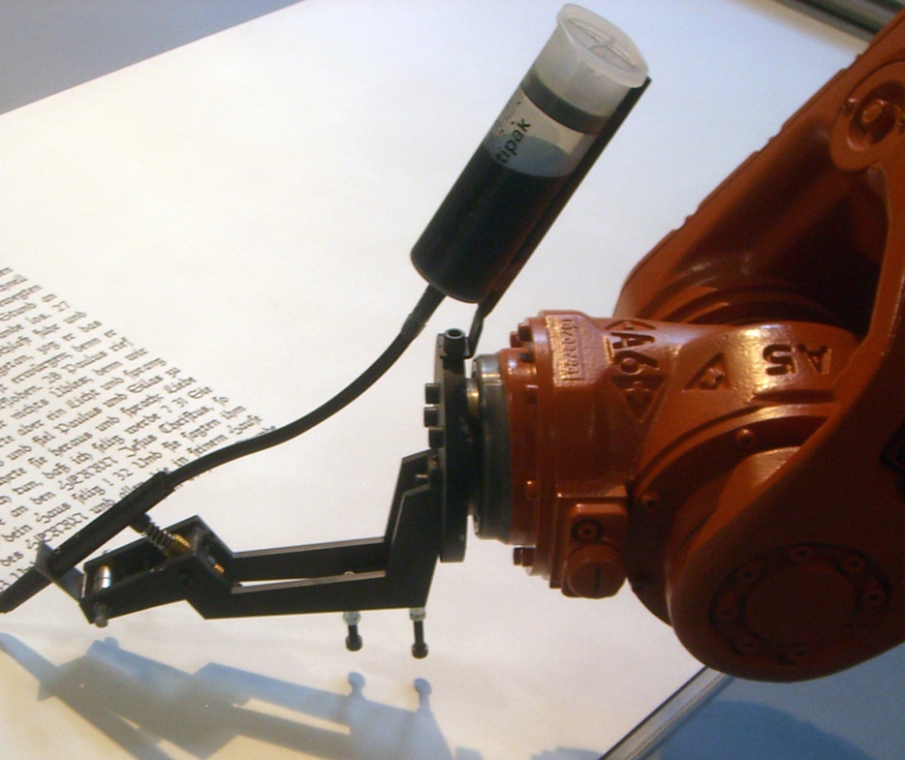
Authorship?
Should Chatgpt be credited as an author?
Nature editorial published in 2023
No LLM tool will be accepted as a credited author on a research paper(…) because any attribution of authorship carries with it accountability for the work, and AI tools cannot take such responsibility.
Researchers using LLM tools should document this use in the methods or acknowledgements sections.
  Tools such as ChatGPT threaten transparent science; here are our ground rules for their use. Editorial Editorial. Nature. 2023;613:612

Slide 38

AI as a tool for reviewing
Neural network model trained on a dataset of 3300 reviews
Capable of predicting future review process results
  AI-assisted peer review. Checco A, Bracciale L, Loreti P, et al. Humanit Soc Sci Commun. 2021;8:1–11.
Applicable to research grant applications?

Slide 39
AI for guidelines?
Current study by Lisette ‘t Hoen, Allon Van Uitert, Christian Radmayr from EAU guidelines panel
Structured guidelines updates:
  Methodology given by the Guidelines Office Methods Committee vs ChatGPT
Interesting results soon to be presented…

Slide 40

AI as a tool for medical education
30% of college students use ChatGPT for their written homework
  Nearly 1 in 3 College Students Have Used ChatGPT on Written Assignments - Intelligent. [ Mar; 2023 ].
But does ChatGPT possess the ability to teach medicine?

Slide 41

Can Chatgpt teach medicine?
Performance of ChatGPT on the United States Medical Licensing Exam
At or near the passing threshold for all 3 exams !
Equivalent of a passing score for a third-year medical student
Showed high internal concordance, low self-contradiction and sound clinical reasoning
  Performance of ChatGPT on USMLE: potential for AI-assisted medical education using large language models. Kung TH, Cheatham M, Medenilla A, et al. PLOS Digit Health. 2023;2:0.
If it can think like a student…

Slide 42
Interestingly, ChatGPT outperformed PubMedGPT
Domain-specific training creates ambivalence
Real-world text that are:
  inconclusive, contradictory, highly conservative or noncommittal
ChatGPT, may therefore have an advantage because it is also exposed to broader clinical content that are more definitive and congruent
Can provide novel and nonobvious concepts

Slide 43
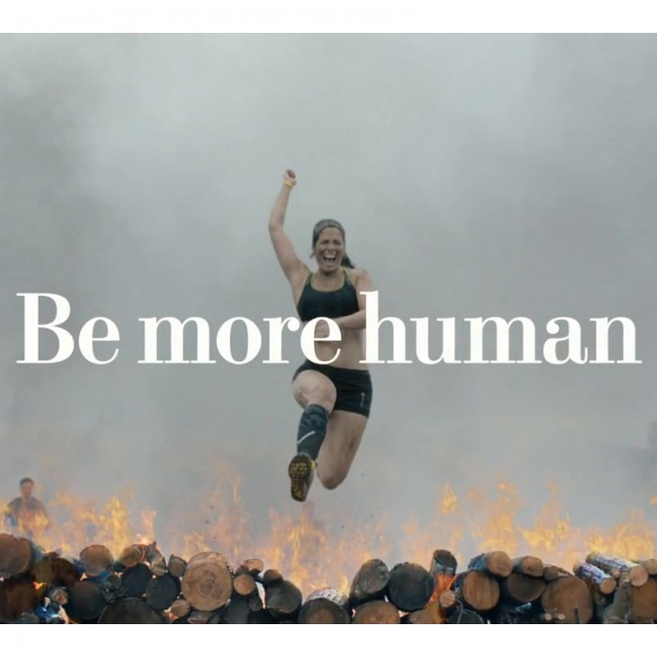
Can allow students to learn to integrate/use data instead of remembering it
Can lead to higher level of understanding individual patients
  Compassionate culturally competent communication
  Physical exam
To be even more human
  Hswen Y, Abbasi J. AI Will—and Should—Change Medical School, Says Harvard’s Dean for Medical Education. JAMA. 2023;330(19):1820–1823.

Slide 44
"A Leap Forward: Harnessing Artificial Intelligence in Medical Research“ title suggested by Chatgpt
Introduction suggested by Chatgpt:
"Picture a scenario where a team of researchers is faced with an overwhelming amount of medical data—millions of patient records, countless scientific articles, and complex genomic sequences. It's a daunting task to sift through this vast sea of information, searching for patterns, insights, and breakthroughs. Yet, in this age of artificial intelligence, what once seemed insurmountable is now within reach. Today, I stand before you to unveil the remarkable journey of AI in medical research—a journey marked by innovation, discovery, and the promise of transforming the landscape of healthcare as we know it.“
Ending phrase:
"As we harness the power of artificial intelligence to unlock the mysteries of disease, let us embrace this journey with unwavering curiosity, determination, and compassion, for in our pursuit of knowledge lies the promise of a healthier, more equitable future for all."

Slide 45
Pitfalls of AI
Notes:
Is drawbacks better?

Slide 46
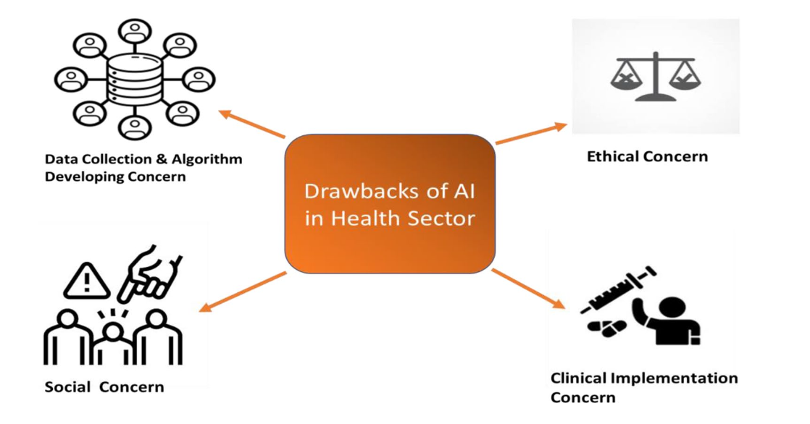
Data collection
Algorithm development
Ethical and social considerations
Accountability and safety

Slide 47

Data collection
Availability of large, relevant patient data is the cornerstone of efficient machine learning and subsequent reliable results
  data protection / confidentiality
  data storage and transfer
Nonexistent legislation on how to obtain and process health data
No possibility to check the input data for errors, which are common in health-care data
Short T1/2 of health / biological systems related data
Khan, B., Fatima, H., Qureshi, A., Kumar, S., Hanan, A., Hussain, J., & Abdullah, S. (2023). Drawbacks of Artificial Intelligence and Their Potential Solutions in the Healthcare Sector. Biomed Mater Devices, 1-8.
Notes:
Example data security: When it was discovered that the NHS had uploaded data on 1.6 million patients to DeepMind servers without the patients’ consent to construct its algorithm, Streams, an app with an algorithm for treating patients with acute renal impairment, came under criticism. A patient data privacy investigation on Google’s Project Nightingale was carried out in the USA. Data privacy is now much more of a problem since the app is now formally hosted on Google's servers

Slide 48
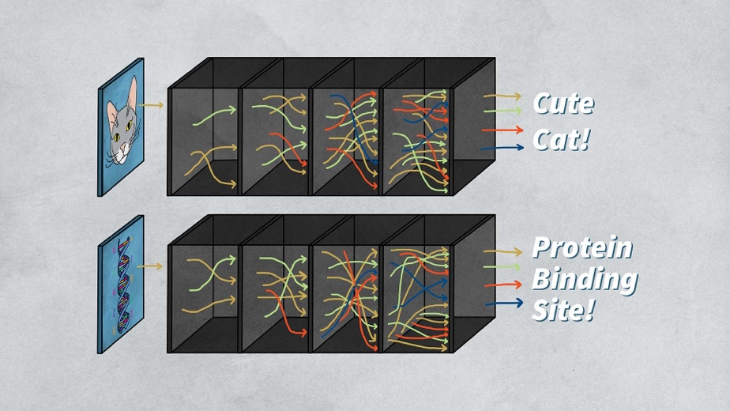
Algorithm / Application development
Black-Box: no explanation for outcomes
Systematic errors / biases if erroneous data informs model creation
Balanced input data: no detection of under-representation of e.g. ethical groups
But why and how?
Is this reversible or explainable?
Khan, B., Fatima, H., Qureshi, A., Kumar, S., Hanan, A., Hussain, J., & Abdullah, S. (2023). Drawbacks of Artificial Intelligence and Their Potential Solutions in the Healthcare Sector. Biomed Mater Devices, 1-8.
Notes:
1. There are papers looking into how the AI can be made comprehensible considering one particular outcome (Dong, X., Yin, H., Alvarez, J. M., Kautz, J., Molchanov, P., & Kung, H. T. (2021). Privacy Vulnerability of Split Computing to Data-Free Model Inversion Attacks. arXiv, 2107.06304v2. Retrieved from http://arxiv.org/abs/2107.06304v2
http://arxiv.org/pdf/2107.06304v2)
2. Google is looking into how to make AI algorithms

Slide 49
Accountability and Safety
improved decision making
widening of responsibility gaps
Any AI tool or its developer is only accountable on the basis of the data included: „algor-ethics“
Data triangulation can re-identify up to 99% even in heavily sampled and incomplete data
Cybersecurity threat: us$6trillion
Safety considerations should be seen as a dynamic process to be followed after deployment of any tool as they will not be fully resolvable during development
Habli, I., Lawton, T., & Porter, Z. (2020). Artificial intelligence in health care: accountability and safety. Bull World Health Organ, 98(4), 251-256. Cacciamani, G. E., Chen, A., Gill, I. S., & Hung, A. J. (2024). Artificial intelligence and urology: ethical considerations for urologists and patients. Nat Rev Urol, 21(1), 50-59.
Notes:
Artificial intelligence systems have shown the potential to improve clinicians’ interpretation and the subsequent decision-making process. The potential benefits of this capability, however, are offset by the widening of responsibility gaps and the additional risk of negative side-effects that are inherent in health-care interventions.
Even with complete de-identification of an anonymous data set, data triangulation techniques can re-identify up to 99% of patients even in heavily sampled and incomplete data sets34.
For consideration of possible ‘algor-ethical’ issues (which are ethical issues related to use of algorithms)56, where the responsibility lies if a machine learning-driven diagnostic tool misses a diagnosis, causing harm to a patient, is a pertinent question. Possibilities include the developer of the hardware and/or software that enables the machine learning algorithm to generate a diagnosis and treatment deci- sions, the urologists who personalized the hardware and/or software decision-making settings to meet the diagnostic thresholds, or both developers and urologists who trained the algorithm.
In 2021, cybersecurity threats were estimated to have cost US$6 trillion globally40 and cyberattacks are the leading cause of secu- rity breaches41, making them of particular interest to the health-care industry. Results of a systematic review including 31 articles inves- tigating cybersecurity trends showed that the health-care industry lags behind other industries in securing vital data42.

Slide 50
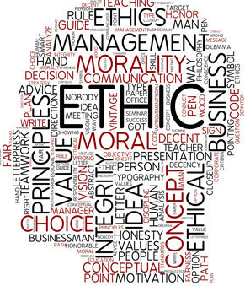
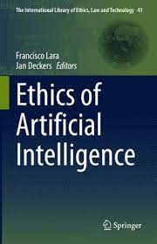
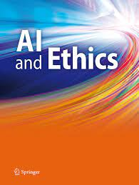
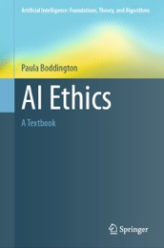
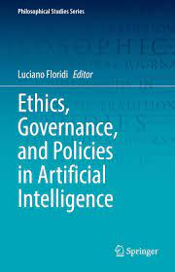
Ethical and social considerations
4 Pillars
  Autonomy
  Beneficience
  Non-maleficience
  Justice
Examples
  Choosing the right tools – standardized reporting
  Preserving the autonomy of the urologist taking the decision
  Ensuring inclusiveness and equity
Cacciamani, G. E., Chen, A., Gill, I. S., & Hung, A. J. (2024). Artificial intelligence and urology: ethical considerations for urologists and patients. Nat Rev Urol, 21(1), 50-59.
Notes:
Reporting guidelines such as SPIRIT-AI, CONSORT-AI, TRIPOD-AI, PROBAST-AI, DECIDE-AI, CLAIM and STARD-AI should be followed (Consolidated Standards of Reporting Randomized Trials (CONSORT-AI)48, Standard Protocol Items: Recom- mendations for Interventional Trials (SPIRIT-AI)49 and Transparent Reporting of a Multivariable Prediction Model for Individual Prognosis or Diagnosis (TRIPOD-AI)50, and also the specially created developmen- tal and exploratory clinical investigations of Decision Support Systems Driven by Artificial Intelligence (DECIDE-AI)51 reporting guidelines)
Example: If an algorithm is applied to predict the probability of clinically significant cancer in patients undergoing prostate biopsy for suspicion of prostate cancer, the methodology should be clear for urologists and patients to ensure a properly informed decision-making process.
Inclusiveness means that AI algorithms used in urology should be applicable to and available to the broadest population of patients possible, irrespective of patient socio-economic disparities or urologist facility differences (for example, urban versus non-urban or teaching versus non-teaching hospitals).

Slide 51
Take Home Messages
AI is much more varied than you might have thought – and much older
It will shape clinical medicine with prediction models, computer vision, signal analysis and prescription models
In science, its use in writing has to be scrutinized – it will be useful in data collection, guideline design and reviewing
Can AI make us „more human“ in teaching and practicing clinical medicine?
Use it wisely: Know the pitfalls and dangers

Slide 52

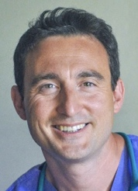
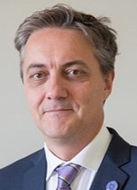
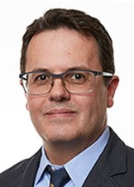

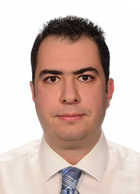

Thank You!
The ESPU Research Committee
Luke Harper
(Chair, FR)
Massimo Garriboli
(UK)
Salvatore Cascio
(IRL)
Luis Braga
(CAN)
Caleb Nelson
(USA)
Anka Nieuwhof-Leppink
(Vice-Chair, NL)
Bernhard Haid
(AUS)
Irfan Donmez
(TUR)
Christina Ching
(USA)

Slide 53
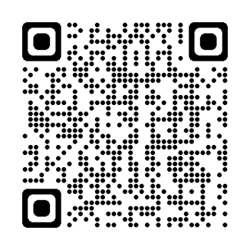

Get involved in the CyPhy trial!

