Slide 1
Chance: The (Surprising) Secrets of Luck, Randomness and Probability
Martin Kaefer
Katherine Herbst
Nicolas Kalfa
Notes:
Thank you for getting up so early to be with us this morning.. We will be your hosts for the next 45 minutes… and we hope to have some fun. To start us off, lets begin with what the three of us enjoy.

Slide 2
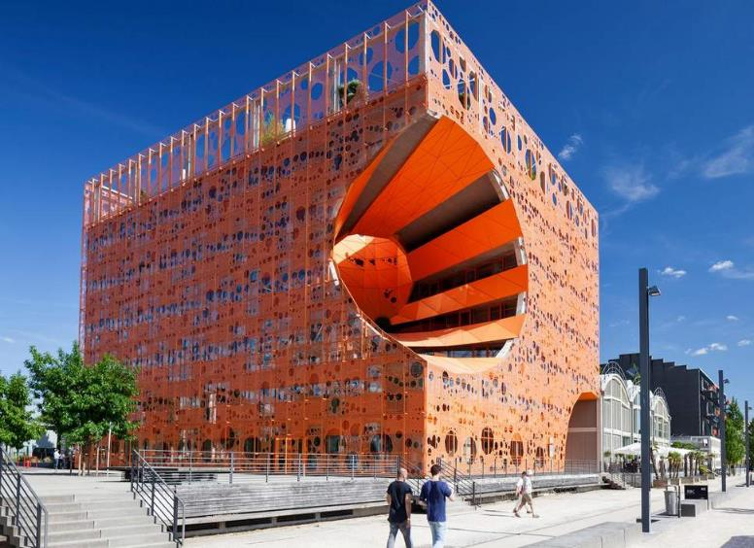
What do we enjoy ?
Le Cube
Orange
Things that are beautiful
Notes:
……– these may be some of the things that you also enjoy. First, we like things that are beautiful. Second…

Slide 3
What do we enjoy ?
Things that are shocking
Notes:
We enjoy things that are shocking. They move us to think of things in a different way.

Slide 4
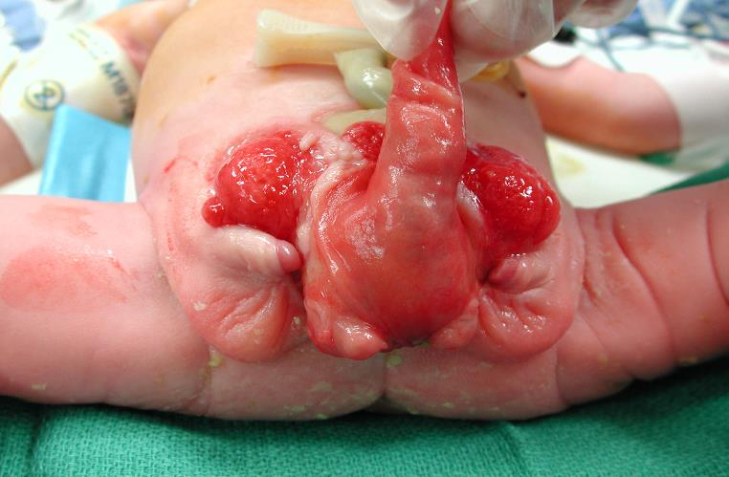
What do we enjoy ?
Questioning Paradigms
Notes:
We enjoy questioning paradigms and learning new truths

Slide 5
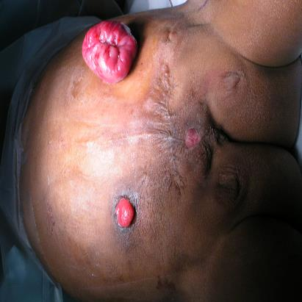
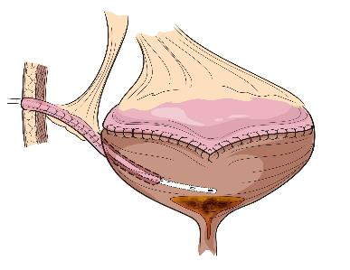
Cloacal Exstrophy Patient:
Provide Urinary Continence at Birth
Continent Reservoir with APV
16 operations (6 urological) + Renal Transplant
Notes:
The standard paradigm in cloacal exstrophy has been to create a continent urinary reservoir in a patient who is going to have a lifelong colostomy and is likely to have many other physical and social challenges. Is this a just and correct goal for these individuals in all cases? (Especially when it means having a much larger need for surgery and a significant risk of renal failure?)

Slide 6
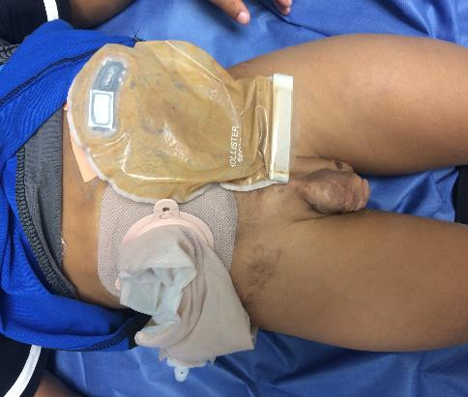
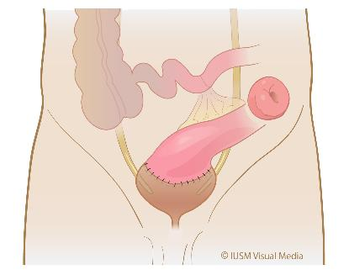
Cloacal Exstrophy Patient:
Keep them Incontinent at Birth
No Additional Urinary Tract Operations
Notes:
After critically looking at our data, we felt it might be good to question this paradigm of treatment in certain patients. We now recommend considering an incontinent option at birth with the option of converting to a continent reservoir at a future date if the patient so wishes. And many of our patients are happy and healthy.

Slide 7
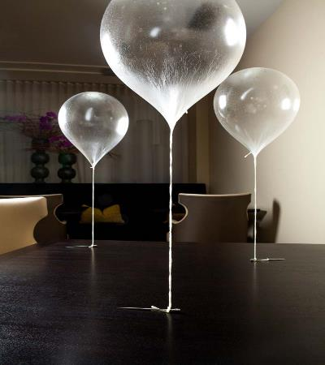
What do we enjoy ?
Experiencing and understanding things that are counterintuitive
Notes:
And we like understanding things that are counterintuitive, that cause us to go ah-ha. We essentially enjoy seeing the world more clearly for what it is. For understanding reality and some of its secrets.
At first you may think you know what this is…but it is in fact

Slide 8
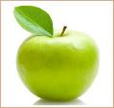
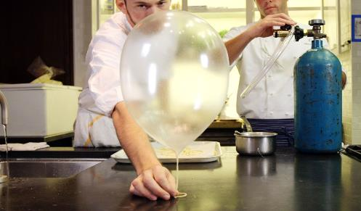
Green Apple (+ Helium)
Notes:
a green apple, processed into a taffy paste
and then inflated with helium to make…

Slide 9
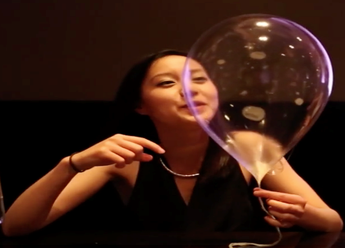
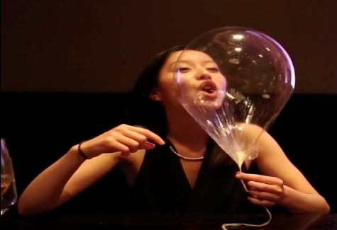
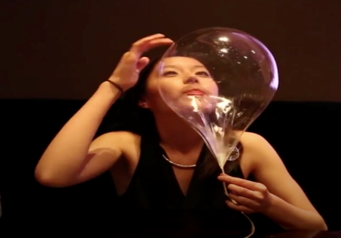
Notes:
A dessert

Slide 10
Goal: To see the
world more clearly
Notes:
All of these enjoyable things allow us to do one thing…..see the world more clearly.
Oh, And one final thing we all like….

Slide 11
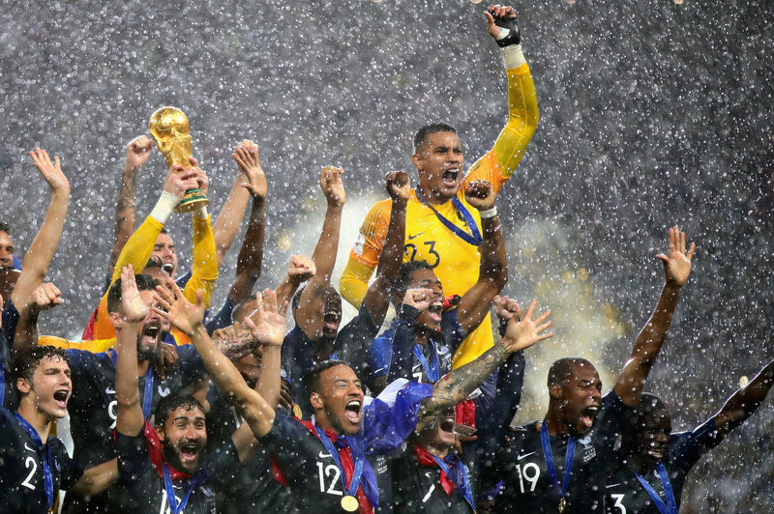
What do I enjoy ?
Winning!
Notes:
winning

Slide 12
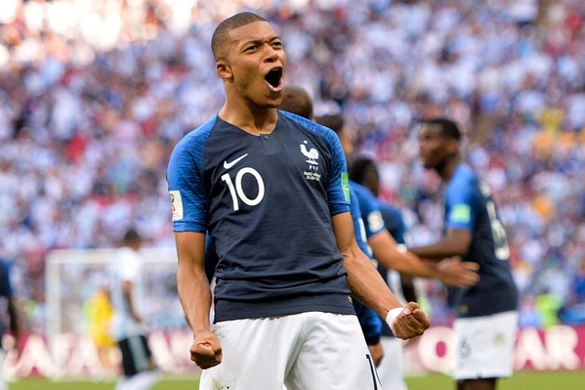
Winning!
Notes:
A lot………. So in this spirit we are going to do the following

Slide 13
Audience Response
Keep Score of how many you get right (Honor system)
Prize will be handed out at the end of the session
Notes:
We are going to spend the next 45 minutes playing a game. And the winner will get a prize. Don’t over think your choices.

Slide 14
XXXXXX
Goal: To see the
world more clearly
Notes:
So again, we want to see the world more clearly. Well, what are some reasons we might we not see it so clearly?

Slide 15
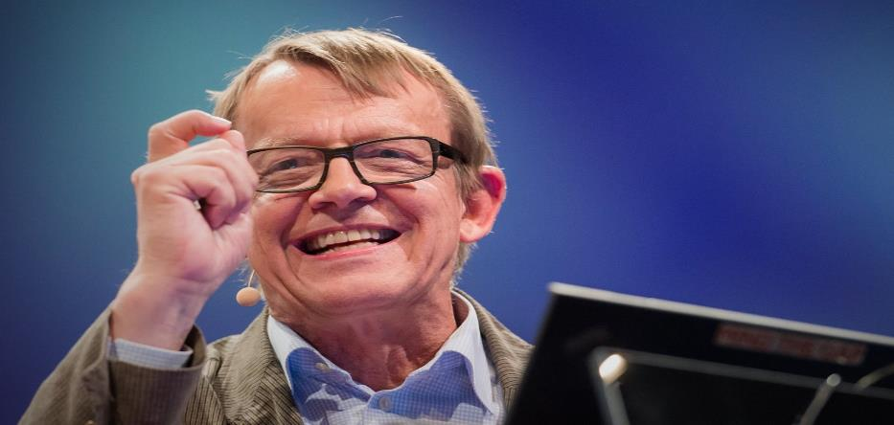
Why might we not see
the world clearly ?
Swedish Doctor
Hans Rosling
Notes:
Lets start by asking a doctor. Maybe even a Swedish doctor. They seem to be pretty smart.
Hans Rosling was a very engaging man. He is known for making even statistics……

Slide 16
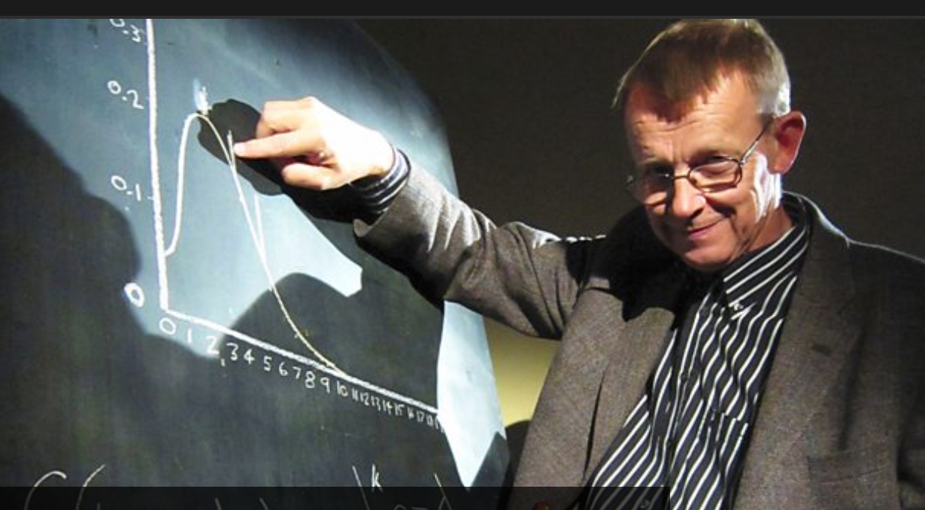
Notes:
Interesting. Here he is in a TV special he helped produce a few years ago. He also has a bestselling book…

Slide 17
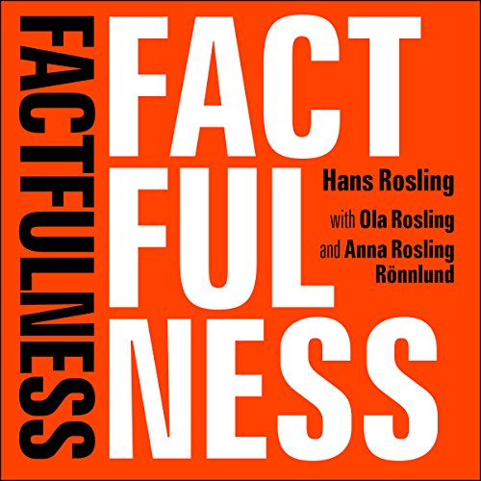
Picture of book factfullness
Notes:
In Factfulness he asks the following questions …

Slide 18
#1
Questions from Hans
Worldwide, 30 year old men have spent 10 years in school on average, how many years have women of the same age spent in school?
9 years
6 years
3 years
Notes:
Please write down you answer to the following.

Slide 19
Questions from Hans
Worldwide, 30 year old men have spent 10 years in school on average, how many years have women of the same age spent in school?
9 years
6 years
3 years
Notes:
And here is the answer. Surprising is it not?

Slide 20
#2
Questions from Hans
Where does the majority of the world population live?
Low Income Countries
Middle Income Countries
High Income Countries
Notes:
Read question

Slide 21
Questions from Hans
Where does the majority of the world population live?
Low Income Countries
Middle Income Countries
High Income Countries
Notes:
I for my part thought it was number one.

Slide 22
#3
Questions from Hans
In the last 20 years the proportion of the world population living in extreme poverty has?
Almost Doubled
Remained Same
Almost Halved
Notes:
Read it…. Got your answer?

Slide 23
Questions from Hans
In the last 20 years the proportion of the world population living in extreme poverty has?
Almost Doubled
Remained Same
Almost Halved
Notes:
Hard to believe isn’t it?

Slide 24
#4
Questions from Hans
Global climate experts believe that over the next 100 years the average temperature will on average?
Get Warmer
Remain the Same
Get Colder
Notes:
Well finally an easy one….ready?

Slide 25
Questions from Hans
Global climate experts believe that over the next 100 years the average temperature will on average?
Get Warmer
Remain the Same
Get Colder
Notes:
Well maybe in this situation you should have trusted your intuition ☺

Slide 26
#5
Questions from Hans
What is the life expectancy of the world today?
50 years
60 years
70 years
Notes:
And lastly, what is the average life expectancy today?

Slide 27
Questions from Hans
What is the life expectancy of the world today?
50 years
60 years
70 years
?
Notes:
Astounding. Now why is it that we get so many of these wrong . Well Goedele, Darius and another Swedish Doctor told us yesterday.

Slide 28
187 Recognized Types
Instinct to Generalize
Notes:
Its Bias. I just happened to look this up on Wikipedia. And guess how many forms of recognized bias there are?
Hans stresses that it is the instinct to generalize that effects us the most.
You see the world based on your own personal last experience, the quantity of information that you experience and yes….

Slide 29
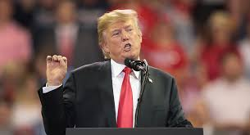
Notes:
Propaganda.

Slide 30
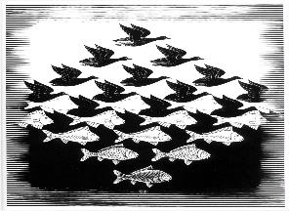
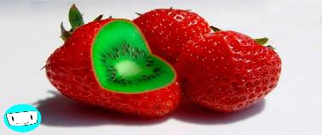
Why might we not see
the world clearly?
Fall Victim to Bias
Notes:
So, first reason we may not see the world clearly s that we fall victim to bias.

Slide 31
Why might we not see
the world clearly?
Fall Victim to Bias
Anecdote?
Notes:
What is the Anecdote…. ?

Slide 32
Why might we not see
the world clearly?
Fall Victim to Bias
Understanding that Bias Exists
Notes:
- Understanding that it exists

Slide 33
Why might we not see
the world clearly?
Fall Victim to Bias
Depend on Intuition
Anecdote?
Notes:
A second reason why we are likely not to see the world clearly is that we depend too much on intuition. And as you will see, this can be misleading. What is at least the partial anecdote or cure to this – if used properly? …

Slide 34
Why might we not see
the world clearly?
Fall Victim to Bias
Depend on Intuition
Statistics
Notes:
……Statistics

Slide 35
And this is why we should care about statistics !!!!
Notes:
And this is why we should care about statistics. Now, many would contend that statistics have their own problems. This guy did…

Slide 36
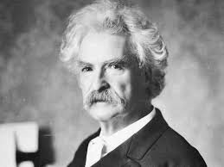
“There are lies, damned lies
and statistics”
Notes:
You may not recognize his face, but you surely have heard Mark Twain’s sentiments about this topic. And even if you don’t think that they are lies…

Slide 37
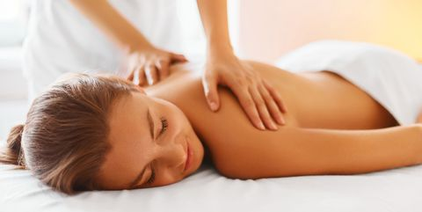
Notes:
We may be extremely skeptical because…. of

Slide 38
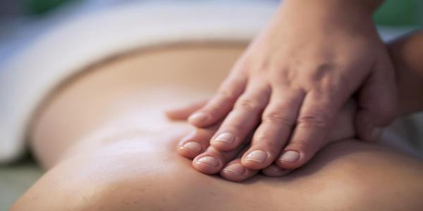
Massaging the Data
Notes:
our concern that data can be gently changed through statistical manipulation. However….

Slide 39
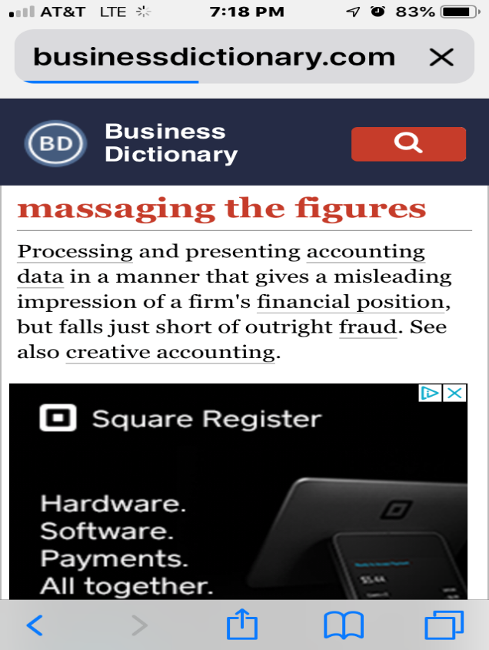
Massaging the Data
Notes:
this makes it even more important to use statistics appropriately to aid in understanding the world around us.
Lets take a brief look at how a very bright Italian man came to help us put our trust in statistics

Slide 40
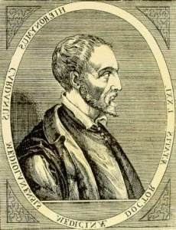
Gerolamo Cardona
1501-1576
Notes:
Its this guy – an Italian you may have never heard of.

Slide 41
A True “Renaissance Man”
Medicine*
Mathematics
Physics
Astrology
Philosophy
Architecture
Religion
Music
The Combination Lock
The Gimbel
Notes:
He was the true Renaissance Man, First he lived in the renaissance , so that helped. He was another doctor….. But he didn’t stop there….He became an expert in nearly every important topic of the day. He was also a prolific inventor.

Slide 42
A True “Renaissance Man”
Medicine*
Mathematics
Physics
Astrology
Philosophy
Architecture
Religion
Music
Gambling
Notes:
But what most interested him, and most nearly all of the elite at that time was…..gambling. And, like us, they most enjoyed winning.

Slide 43
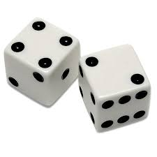
Gambling
So there is one general rule, namely, that we should consider the whole circuit, and the number of those casts which represents in how many ways the favorable result can occur and compare that number to the rest of the circuit, and according to that proportion should the mutual wagers be laid so that one may contend on equal terms
Notes:
They didn’t bet on soccer scores or horses, they bet on dice. This was one of the famous quotes from his master work. Don’t even try and read it.

Slide 44
Gambling
If
r is the number of favorable outcomes and
s is the number of unfavorable outcomes
Then
the corresponding probability is
r/(r+s)
Notes:
Here are his words in a format that we can perhaps better understand.

Slide 45
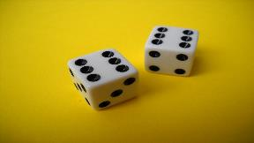
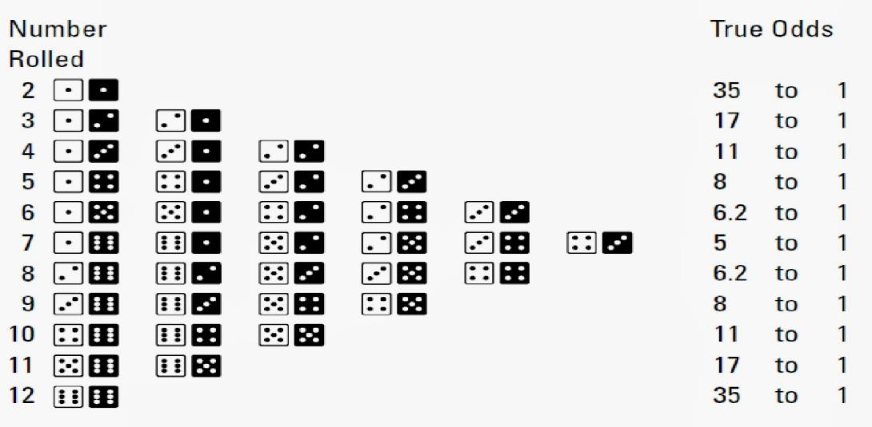
r/(r+s)
Notes:
Here is how it pertains to dice

Slide 46
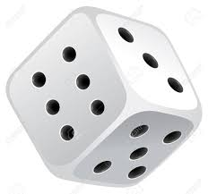
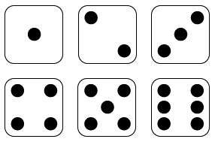
#6
Chance of rolling a 6
1/3
1/4
1/6
0
Notes:
Which leads us to question #6. what is the probability that you will roll a 6 if you roll the dice once? Write down your answer.

Slide 47
Chance of rolling a 6
1/3
1/4
1/6
0
1/1+5 = 1/6
Notes:
It is of course 1/1+5 or 1/6

Slide 48
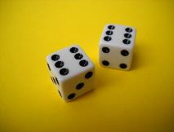
#7
Chance of rolling a double 6
1/6
1/18
1/36
1/72
Notes:
Now what is the probability that you will roll two sixes with one throw of two dice?

Slide 49
Chance of rolling a double 6
1/6
1/18
1/36
1/72
Notes:
Again, many of you probably found this easy.

Slide 50
Cardona’s Formula
Independent Events
Multiply the Probabilities
Chance of rolling a double 6
1/6 x 1/6 = 1/36 or (1/6)²
Notes:
You multiply the two probabilities – everyone has learned this at some point. - This has been termed by some to be Cardona’s Rule.
Interestingly, when he came up with the idea he initially claimed that one should multiply the odds – but he quickly realized his mistake.

Slide 51
Cardona’s Formula
Independent Events
Multiply the Probabilities
Chance of rolling a N number of 6’s in a row?
1/6 x 1/6 x 1/6 ….. = (1/6)^{N}
Notes:
And if we take this further we realize that if we have N independent events then the probability will be that of an individual event to the Nth power.
So far so good, right?

Slide 52
How many rolls do you need to have a 50% chance of rolling one double 6?
#8
Remember… chance of rolling a double 6 with one roll is 1/36
18
25
32
36
None of the above
Notes:
This is easy. Now let us examine the problem that was posed to Cardona by some of the wealthy gamblers of his time….. How many rolls do you need to have a 50% chance of rolling one double 6…… Remember that the chance of rolling a single double six is 1/36 .

Slide 53
How many rolls do you need to have a 50% chance of rolling one double 6?
Remember… chance of rolling a double 6 with one roll is 1/36
18
25
32
36
None of the above
Notes:
Guess what……. Its not 18.

Slide 54
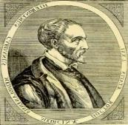
How many rolls do you need to have a 50% chance of rolling one double 6?
Remember… chance of rolling a double 6 is 1/36
Intuitively you may reason on the mean
But this will give you the wrong answer
(your intuition is wrong… why?)
Notes:
Now, intuitively you may reason on the mean. But this will give you the wrong answer. Why?

Slide 55
How many rolls do you need to have a 50% chance of rolling one double 6?
Remember… chance of rolling a double 6 is 1/36
Reasoning on the mean will give you the wrong answer
(your intuition is wrong… because it is wrong)
Notes:
Because it does. So here was his secret…. In order to figure out the probability of it happening you have to first….

Slide 56
How many rolls do you need to have a 50% chance of rolling one double 6?
Remember… chance of rolling a double 6 is 1/36
To find out the correct answer you have to first figure out the probability that an
event will not occur!
Notes:
Figure out the probability that it will not occur….. And then subtract from 100%

Slide 57
How many rolls for 50% chance of a double six?
For one roll: 1/6 x 1/6 = 1/36
35/36 chance you will not
If n roles then probability will be (35/36)^{n}
you will not roll a single double 6
Therefore, the probability you will roll a double 6
would be 1-(35/36)^{n}
For 1-(35/36)^{n} > ½, n >24.6!!
Notes:
Here it is explained
Strange? Yes
Reality? Yes
Pretty amazing. We cannot fully depend on our intuition.!

Slide 58
Founder of Probability
Gerolamo Cardona
1501-1576
Notes:
And for this work Cardona should rightly be called the Founder of Probability…. But he usually is not. Who takes credit instead? Well…..

Slide 59
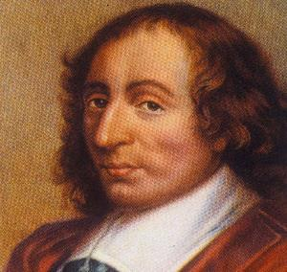
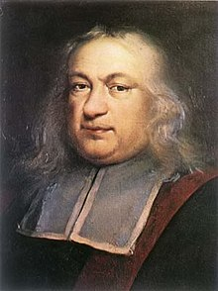
Founders of Probability Theory ?
Blaise Pascal
Pierre Fermat
1623-1662
1601-1665
Notes:
The French!!! Somehow they got the credit. Does anyone know why…?

Slide 60
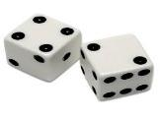
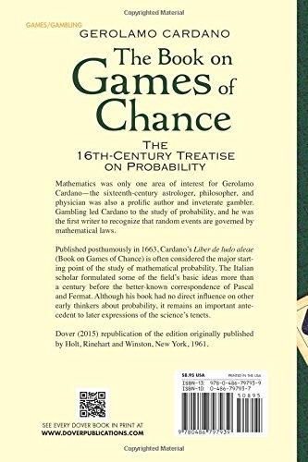
Gerolamo Cardona
1501-1576
Published
1663
Notes:
Because this book which included all of his early ideas including a section on effective cheating methods, …….translated into English as the Book on Games of Chance……. was published in 1663, Which leads us to an Important lesson….

Slide 61
Important Lesson #1
Don’t Delay in Publishing !
Notes:
#1. Don’t delay in publishing!

Slide 62
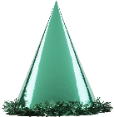
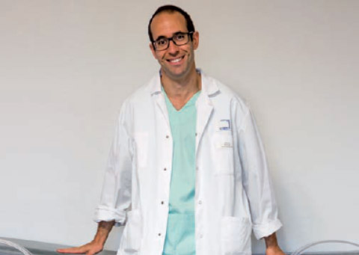
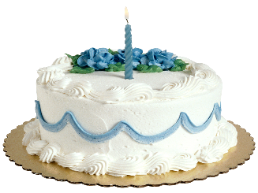
Notes:
At this point, we would like to have a well spoken Frenchman come to the podium to explain another entertaining example..

Slide 63
#9
Question from Nicolas
If there are 23 people in a room, what is the probability that
any two will have the same birthday?
0.5%
5.0%
50%
Notes:
By birthday we mean march 3rd or September 16th or the like. Does everyone have their answer?

Slide 64
Question from Nicolas
If there are 23 people in a room, what is the probability that
any two will have the same birthday?
0.5%
5.0%
50%
Why might you have chosen the wrong answer?
Notes:
Shocking, isn’t it ? In fact its more than 50%.

Slide 65
If there are 23 people in a room, what is the probability that you will have the same birthday as someone else?
Chance that you will with one person: 1/365 = 0.0028
Chance that you won’t with one person: 364/365 = 0.9972
If n possibilities then probability will be (364/365)²²
you will not have the same birthday = 0.940
1-(364/365)²² = 0.060 or 6%
Notes:
Here is what you may have thought was going on. But…

Slide 66
If there are 23 people in a room, what is the probability that you will have the same birthday as someone else?
Chance that you will with one person: 1/365 = 0.0028
Chance that you won’t with one person: 364/365 = 0.9972
If n possibilities then probability will be (364/365)²²
you will not have the same birthday = 0.940
1-(364/365)²² = 0.060 or 6%
Notes:
this is a very egocentric way of looking at the problem. Its not just about you!

Slide 67
If there are 23 people in a room, what is the probability that any two will have the same birthday?
How Many Pairs are Possible? – not just 22
2 x 1
2
2 people
1 pair
2
2
3 x 2
6
3 people
3 pairs
2
2
4 x 3
12
4 people
6 pairs
2
2
23 x 22
506
23 people
258 pairs
2
2
Notes:
In fact, there are quite a few more possible pairs of individuals that can have the same birthday.
It follows from the law of permutations, that if there are two people, there can be one pair.
If there are 3 people there are three possible pairs and so on.
So for 23 people there are a total of 258 possible pairs

Slide 68
If there are 23 people in a room, what is the probability that anyone will have the same birthday as someone else?
Chance that two will: 1/365 = 0.0028
Chance that two won’t: 364/365 = 0.9972
If 258 possibilities then probability will be (364/365)²⁵⁸
any two will not have the same birthday = 0.485
1-(364/365)²⁵⁸ = 0.515 or 51.5% !!!!
Notes:
And so to have a condition in which none of the 258 total possible pairs have the same birthday, you need to raise it to the 258th power. So in the room, there is a 48.5% chance of there not being any individual pair with the same birthday…….. Or a 51.5% chance that there is!!

Slide 69
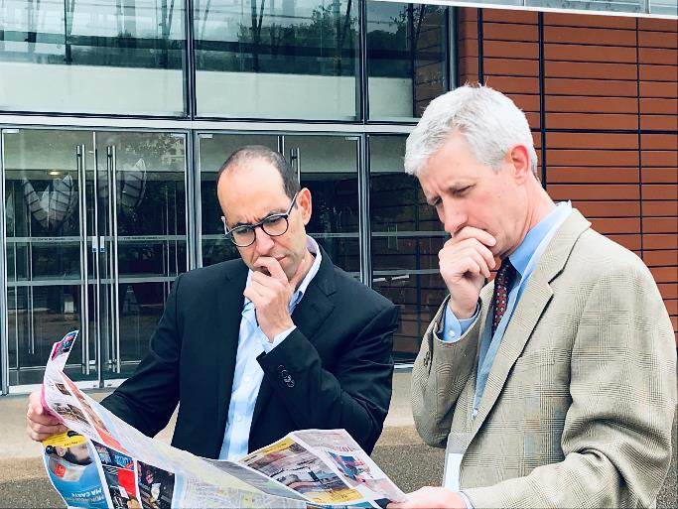
Important Lesson #2
Use your Intuition as your guide…
Notes:
So lesson number 2 is what? Use your intuition as your guide, but…..

Slide 70
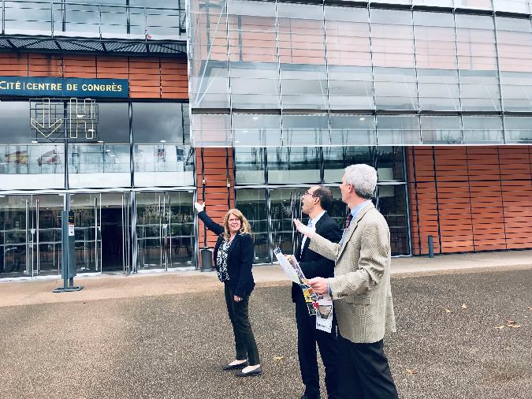
Important Lesson #2
Use your Intuition as your guide…
But bring a statistician along for the journey
Notes:
bring a statistician along for the journey.

Slide 71
Notes:
And this Journey continues this afternoon at 4:45!

Slide 72
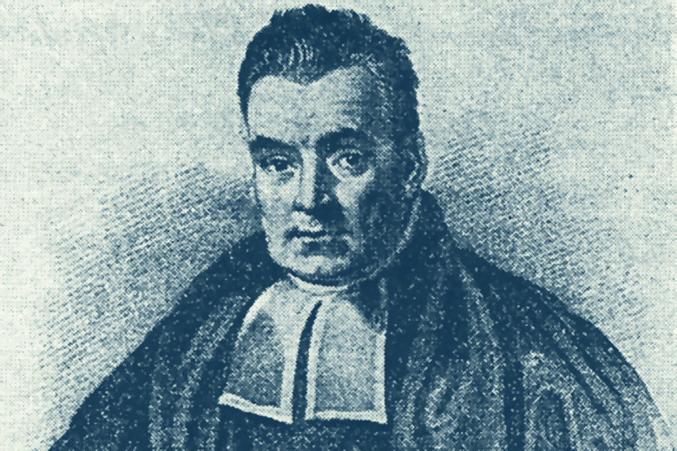
1702-1761
English Minister
Notes:
The next highly entertaining area of probability brings us to this relatively serious looking fellow. An Englishman. Bayes was the individual who gave us incredible insight into this arena of probability. And this was in respect to our understanding of

Slide 73
Conditional Probability
Notes:
Conditional Probability. This is Bayes Formula….

Slide 74
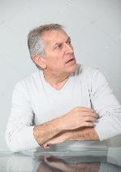
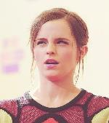
The probability of event A occurring given that B is true
is equal to
The conditional probability of event B occurring given that A is true,
Multiplied by the probability of observing the condition A
Divided by the probability of B.
Notes:
Confused? , scared?
….. Its actually a truly amazing formula that explains a lot of really cool stuff. For example this helps explain the Monty Hall Problem. What is the Monty Hall Problem you may ask?

Slide 75
I know what is behind the doors
Notes:
Well, it’s a game. Lets play. Behind one of these doors is a car, while behind the other two are goats. Lets assume for arguments sake that you prefer cars. You get to choose one of the doors. Which one will it be?

Slide 76
I know what is behind the doors
✔
Notes:
You pick three. So now in this game I am going to open one of the other doors to show you what is behind it. Remember, that I know what is behind the other doors, so I am going to open one that has a goat.

Slide 77
I know what is behind the doors
✔
Notes:
Behind door number 2 is a goat. So now comes the interesting part of the game - -- I offer you the option of switching to door one, or keeping number 3? What do you want to do?

Slide 78
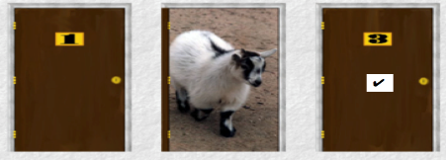
#10
Question from Martin
What is your chance of winning the car if you switch?
Lower
Same
Greater
Notes:
It basically boils down to this? Have you written down your answer?

Slide 79
Question from Martin
What is your chance of winning the car if you switch?
Lower
Same
Greater
Notes:
And its actually Greater. In fact…

Slide 80
Question from Martin
What is your chance of winning the car if you switch?
33%
50%
66%
Notes:
Your chances are twice as good of winning if you switch. How can this be ???

Slide 81
____
____
____
Goat
1
2
3
Switch ?
____
____
____
Goat
CAR
Goat
1
2
3
Notes:
Well. And this is worth paying attention to………..
Here is the problem again.
Do you Switch?
Well lets say this is how they are arranged.
If you pick door 1, then I show you door 3
If you pick door two, then I can show you either one
If you pick door 3, then I show you door 1
So what is the probability If you….

Slide 82
____
____
____
1
2
3
____
____
____
Goat
CAR
Goat
1
2
3
Don’t Switch
1
P (W)
3
2
P (L)
3
Notes:
……. don’t switch? Well…the probability of you winning is 1/3 rd and the probability of you losing is 2/3rds

Slide 83
____
____
____
1
2
3
____
____
____
Goat
CAR
Goat
1
2
3
Don’t Switch
Always Switch
1
How do you win ?
1) Pick Wrong
2) Always Switch
2
P (W)
P (W)
3
3
2
How do you lose ?
1) Pick Right
2) Always Switch
1
P (L)
P (L)
3
3
Notes:
Now what if you always switch? Well lets think of the scenerios…..
When would you win? You would have to first pick wrong – what is the chance of picking wrong? 2/3rds
And what is the chance of initially picking right and then switching? 1/3rd. And there you have it !!

Slide 84
____
____
____
1
2
3
2
3
3
1
____
____
____
Goat
CAR
Goat
1
2
3
Don’t Switch
Always Switch
1
How do you win ?
1) Pick Wrong
2) Always Switch
2
P (W)
P (W)
3
3
2
How do you lose ?
1) Pick Right
2) Always Switch
1
P (L)
P (L)
3
3
Notes:
Perhaps an even easier way to think of it would be like this…..
In the beginning you have a 1/3rd chance of winning leaving 2/3rds chance of winning remaining. Would you rather have 2/3rds of the choices or 1/3rd?

Slide 85
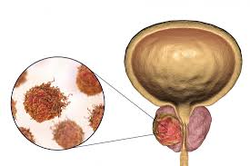
PSA
Prostate Cancer
Notes:
The Bayes formula can be used to actually prove this. But lets look at something more relevant than cars and goats. Lets look at a clinical situation. The Bayes Conditional Probability formula helps us with real life clinical problems. Lets say for example that you have a patient with an elevated test for cancer. If we focus on simple parameters like sensitivity and specificity we can make some very interesting predictions.

Slide 86
Presence of Condition
-
+
+
5
98
Test
Result
-
95
2
Notes:
Here is a table that we should all be familiar with. It shows us the number of subjects that test positive or negative and whether or not the disease is present or absent.

Slide 87
Presence of Condition
-
+
+
5
98
Test
Result
-
95
2
Probability you will test positive for the condition given you have the condition
Sensitivity = 98/100 = 98%
Probability you will not test positive given you do not have the condition
Specificity = 95/100 = 95%
Notes:
We have some commonly understood definitions. For example Sensitivity. Read the definition. Which in this case would be 98 over a total of 100 (one can say there are 98% true positives)
And Specificity…… (one could say there are 95% true negatives)

Slide 88
Presence of Condition
-
+
+
5
98
Test
Result
-
95
2
If 1% of the population has the condition, what is the probability that
if you have a positive test that you have the condition?
Sensitivity x Incidence
(Sensitivity x Incidence) + (Complement of Specificity x Complement of Incidence)
Notes:
Now if only 1% of the population has this condition,
We simply plug the data in to the Bayes formula…. And get

Slide 89
Presence of Condition
-
+
+
5
98
Test
Result
-
95
2
If 1% of the population has the condition, what is the probability that
if you have a positive test that you have the condition?
(0.98 x 0.01)
= 0.1653 = 16.53%
(0.98 x 0.01) + (0.05 x .99)
Notes:
For a low probability event with a high sensitivity and less than ideal specificity, the probability that someone who tests positive has the disease is relatively low.
(This is because the disease incidence is low, and due to less than perfect specificity there are more healthy people with a positive test than there are people with the disorder that have a positive test) Raise the specificity of the test and this phenomenon is not as profound)
However, what if the test is done twice?

Slide 90
#11
Question from Kathy
What is the probability if you test positive twice that you have the disease (conditional on fact that you tested positive the 1st time)
16.5%
33.0%
66.0%
80.0%
Notes:
So now what is truly fascinating… What ….

Slide 91
Question from Kathy
What is the probability if you test positive twice that you have the disease (conditional on fact that you tested positive the 1st time)
16.5%
33.0%
66.0%
80.0%
Notes:
It goes up to almost 80%.

Slide 92
Presence of Condition
-
+
+
5
98
Test
Result
-
95
2
If 1% of the population has the condition, what is the probability that
if you have a positive test that you have the condition?
(0.98 x 0.98 x 0.01)
= 0.795 = 79.5% !!!
(0.98 x 0.98 x 0.01) + (0.05 x 0.05 x 0.99)
Notes:
Here is the math – with cardona’s rule nestled inside

Slide 93
Presence of Condition
-
+
+
5
98
Test
Result
-
95
2
If 1% of the population has the condition, what is the probability that
if you have a positive test that you have the condition?
(0.98 x 0.98 x 0.01)
= 0.795 = 79.5% !!!
(0.98 x 0.98 x 0.01) + (0.05 x 0.05 x 0.99)
Notes:
Here is the math – with cardona’s rule nestled inside

Slide 94
Why might we not see
the world clearly ?
Fall Victim to Bias
Depend on Intuition
Notes:
A third reason we may not see the world so clearly is because…

Slide 95
Why might we not see
the world clearly ?
Fall Victim to Bias
Depend on Intuition
Fail to Understand that Statistical Significance is not Synonymous with Truth
Notes:
… we equate statistical significance with truth.

Slide 96
Meaning of the P Value
Notes:
Which brings us to the meaning of the P value. What is statistically significant? Well. If we go to google…

Slide 97
Notes:
We find the following. Most commonly a p value of less than 0.05 is used. What does this mean? This means that…it is deemed to be statistically significant if the probability of the phenomenon being random is less than one in twenty or less than 5%. Interesting

Slide 98
Who decided that P < 0.05 was significant?
Notes:
Who decided that this 0.05 was the mark for something being statistically significant? Well… it was

Slide 99
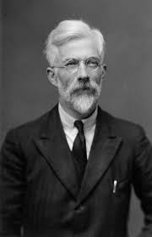
Ronald Fisher
British Statistician
1890-1962
Notes:
Ronald Fisher. But he never really intended for this value to be fixed.

Slide 100
P < 0.05
So is it ok if the probability of the effect being random is 1/20 ?
Notes:
So is it ok if the probability of the result being random is 1/20? Maybe. But Maybe not. For example….

Slide 101
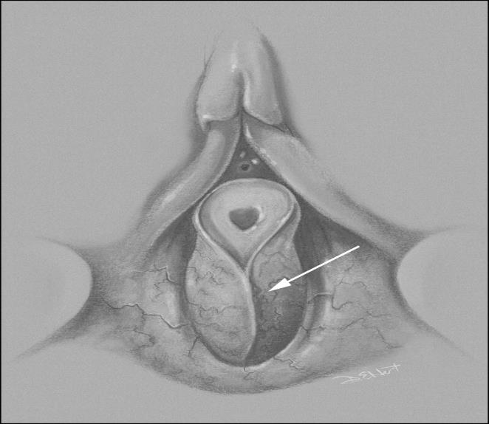
P < 0.05
So is it ok if the probability of the effect being random is 1/20 ?
Labial Adhesions
Notes:
Many of us would accept the probability of the effect being random 1/20 times if it concerns labial adhesions being treated with steroids.
However,….

Slide 102
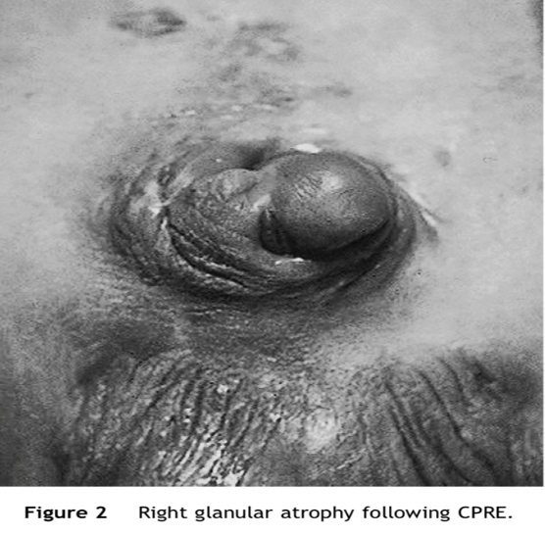
P < 0.05
So is it ok if the probability of the effect being random is 1/20 ?
Notes:
if it pertains to the risk of losing half a penis during an exstrophy closure, is 5% chance of the finding being random good enough? Or to push this argument even farther…

Slide 103
P < 0.05
So is it ok if the probability of the effect being random is 1/20 ?
Boeing
737 Max 8
Notes:
…is is adequate when utilizing new softwear in a Boeing Airplane. Or should we demand more!

Slide 104
What is Significant Enough?
1
P < 0.05
5%
20
1
P < 0.01
1%
100
1
P < 0.001
0.1%
1000
1
P < 0.0001
0.01%
10000
Notes:
So here is what the various P values mean. So you might ask?
Who decides were the threshold is placed?

Slide 105
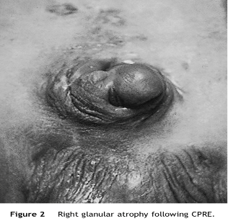
P < ?
Who decides?
We do
Notes:
Well, We do. It is our job to discuss, debate and decide what standard we need to have before we think the evidence is adequate. This is why we come to meetings.

Slide 106
What is Significant Enough?
1
P < 0.1
10%
10
1
P < 0.05
5%
20
1
P < 0.01
1%
100
1
P < 0.001
0.1%
1000
1
P < 0.0001
0.01%
10000
Notes:
On the flipside, one might ask what makes P<0.1 lack importance? Nothing actually. If there is a groundbreaking finding with huge import and you find that there is a 90% chance that your results were not due to random chance….. Should you report them? I for one at would be willing to listen.

Slide 107
Important Lesson #3
Statistical Significance does not Equal Truth
Ask not what is statistically significant, but what is important (the degree of randomness you would be willing to accept) in the context of what is being considered.
Notes:
So important lesson #3 follows

Slide 108
Why might we not see
the world clearly ?
Fake News
Notes:
And finally, what is the final reason we may not see the world clearly? Because the information we re receiving is false.

Slide 109
Notes:
To hear more about this you should come to tomorrows presentation. Thank you for your attention. !

